Slide 1
COMMON MEDICAL SURGICAL CONDITIONS
By collo

Slide 2
CELLULITIS
This is direct spread of infection of the tissues in the extracellular spaces.
Cause:
Bacteria which release toxins into the subcutaneous tissues, streptococci and staphylococcus.

Slide 3
Predisposing factors
Cracks and fissures in the skin e.g. between toes
prick / injection sites
contusions
abrasions
ulcerations
in-growing toenails

Slide 4
Pathophysiology
allows bacteria to enter and release toxins in the subcutaneous tissues

Slide 5
Signs / symptoms
Acute onset of swelling
localized redness( patches)
pain
fever
chills
sweating
tender enlarged lymph nodes
Skin sore or rash that starts suddenly, and grows quickly in the first 24 hours
Tight, glossy, stretched appearance of the skin
Warm skin in the area of redness

Slide 6
DIAGNOSIS
History taking
Physical examination
Complete blood count
Blood culture

Slide 7
Medical Management
Oral antibiotic therapy in OPD if mild( cephalexin, amoxicillin and cloxacillin)
Erythromycin and clindamycin are given to those patients allergic to penicillins.
if severe, - admit, identify site of entry, IV antibiotics for 7 – 14 days to prevent recurrences
Analgesics for pain
Removal of dead tissues

Slide 8
Nursing Care
Elevation of affected area higher than your heart to reduce swelling.
warm moist packs at site for 2 – 4 hours with special attention for those with circulatory deficits e.g. diabetes to prevent burns
education on prevention of recurrence
skin and foot care for diabetics

Slide 9
COMPLICATIONS
Subcutaneous abscess
Blood infection (septicaemia)
Bone infection (osteomyelitis)
Inflammation of the lymph vessels (lymphangitis)
Inflammation of the heart (endocarditis)
Meningitis
Shock
Tissue death (gangrene)

Slide 10
ABSCESSES / FURUNCLES (BOILS)
An abscess is an acute inflammatory condition surrounding a hair follicle, with pus and one opening for drainage.
A furuncle is an acute inflammation arising deep in one or more hair follicles and spreading into the surrounding dermis.
More prevalent to areas subject to irritation, pressure, friction, and excessive perspiration such as the back of the neck, axilla and the buttocks.
Cause: Staphylococcal pyogens

Slide 11
Signs and symptoms
Localized itching pimple which increases in size
Surrounding area becomes hardened and painful
pus forms, a yellow discharge occurs,
sloughing is replaced by granulation tissue as healing commences.
If healing / resolution occurs without pus, it is known as a `blind boil`.

Slide 12
CARBUNCLE
This is a large number of abscesses / boils close together in a mass due to infection of multiple hair follicles especially at the back of the neck (NB> Diabetics are prone)

Slide 13
Management for boils and Cabuncles
Urine is tested for sugar
if present, administration of insulin
administration of appropriate antibiotics
if pus is present, incision and drainage

Slide 14
SUBCUTANEOUS ABSCESS
This is a frequent complication of cellulitis
Signs and symptoms: Classical signs and symptoms of inflammation are present (see cellulitis)
Treatment: as above

Slide 15
LYMPHANGITIS AND LYMPHADENITIS
LYMPHANGITIS
Inflammation of the lymphatic vessels between the site of infection and the regional lymph glands, with characteristic red lines e.g. on the arm or leg of a patient suffering from a septic finger or toe.
Recurrent episodes of lymphangitis are associated with progressive lymph-edema due to obstructed lymph drainage preventing protein molecules from returning to the circulation from the interstitial fluid.

Slide 16
LYMPHADENITIS
Is inflammation of the lymph nodes (glands) or invasion by microorganisms carried through the lymphatic vessels which become enlarged, swollen and tender (i.e. acute lymphadenitis) or may necrose to form an abscess (i.e. suppurative lymphadenitis).
Lymphangitis may be a sign that a skin infection is getting worse.

Slide 17
Cont…
Common sites: The neck – from face, mouth, tongue and scalp; the axilla – from breast and upper limb; the groin – from lower limb, groin and perineum.
Cause: Hemolytic streptococcus
After acute attacks, an elastic compression stocking or sleeve should be worn on affected extremity for several months to prevent long term edema.

Slide 18
Signs and symptoms
Chills
Enlarged and tender lymph nodes (glands) -- usually in the elbow, armpit, or groin
Fever
General ill feeling (malaise)
Headache
Loss of appetite
Muscle aches
Red streaks from the infected area to the armpit or groin (may be faint or obvious)
Throbbing pain along the affected area

Slide 19
Diagnosis
History taking
Perform a physical exam, which includes feeling your lymph nodes.
Look for signs of injury around swollen lymph nodes.
A biopsy and culture of the affected area may reveal the cause of the inflammation.
A blood culture may be done to see if the infection has spread to the blood.

Slide 20
Management
Antibiotics to treat any infection
Pain medicine to control pain
Anti-inflammatory medicines to reduce inflammation and swelling
Warm, moist compresses to reduce inflammation and pain

Slide 21
BACTEREMIA
Definition
Laboratory proven presence of bacteria in the bloodstream.
Causative organism: Mainly staphylococcal
Causes
Nosocomial infections
Vascular access device (VAD) short or long term
Contamination can occur from the patient`s own flora access to exterior of a cannula / brannula during manipulation:
Contaminated intravenous fluids.
Indwelling catherters.
Dental procedures( occasionally can be caused by tooth brushing)

Slide 22
Diagnosis
Compete blood count
Blood culture

Slide 23
Prevention
Washing of hands and asepsis during procedures; for central catheter insertion, full surgical technique – face mask, scrubbing, gowning, gloving and draping of patient
Disinfection of skin with chlorhexidine gluconate (hibitane) povidone iodine or alcohol; gauze dressings used should be sterile and sealed along the entire perimeter.
Give antibiotic before surgical procedures ie dental procedures

Slide 24
Cont…
Indications that patient has VAD Bacteremia
Brannula /cannula in situ, patient appears septic but has no obvious reason to suggest sepsis
Vascular line insertion site is red, swollen or draining pus
Patient has an IV line at onset of sepsis
No infection at another body site
Infection is caused by common skin organims (staphs, bacilli or corynebacterium)
Patient remains septic after therapy but device still in situ

Slide 25
Administration of antibiotics according to culture and sensitivity

Slide 26
Nursing intervention
Monitor patient for evidence of infection to promote early detection and treatment
Assess treatment effectiveness of all identified infections as the course of some infections may be rapid if treatment is not given
Administer antibiotics, first dose promptly to improve outcomes

Slide 27
SEPTICAEMIA
Is persistence multiplication of live bacteria in the blood. If untreated, patient goes into septic shock.
Results from gram –ve bacteria
Cocci (neisseria miningitidis, neisseria gonorrhoeae
Escherichia – coli
Salmonella

Slide 28
Signs and symptoms of septicaemia
Hyper-dynamic shock:
Sudden high fever and chills,
rapid strong pulse (tachycardia ^ 90 bpms),
rapid deep gasping respirations (hyperventilation),
BP normal or slightly low,
skin is flushed, warm and dry with dehydration,
changed mental status( confusion, anxiety,)
Abdominal pains
Nausea, vomitting, diarrhea

Slide 29
Cont…
If infection is not treated
Hypo-dynamic (hypovolemic) shock:
Pallor of mucous membranes,
Cold clammy skin (due to vasoconstriction),
Hyperventilation due to hypoxemia,
Rapid weak thready pulse and
Decreasing blood pressure (hypotension) as more plasma leaks into tissues
Concentrated urine with low output (oliguria), diaphoresis

Slide 30
Management of septicaemia
Administration of intravenous antibiotics immediately awaiting laboratory results
X
3Then administer antibiotics according to culture and sensitivity results
Fluid replacement – septic shockin case ofseptic shock
Oxygen administration
Antipyretic measures to maintain normal temperature and respiratory status
Removal of invasive piece of piece of equipment-catheter
Total nursing care

Slide 31
complications
Endocarditis
Pericarditis
Meningitis
Osteomyelitis
Septic shock

Slide 32
PYAEMIA
Is a grave form of septicemia in which blood borne bacteria lodge and grow in distant organs e.g. brain, kidneys, heart, lungs etc. to form multiple abscesses (covered under affected organs/systems)
Treatment
This will depend on the site of the abscess.

Slide 33
TOXEMIA/TOXIC SHOCK SYNDROME(TSS)
This is a life threatening disease in response to toxins produced by strains of staphylococcus aureas mainly associated with menstruation e.g. in use of tampons.
Non – menstrual predisposing factors of blood poisoning include
Absorption of toxins from a local site of infection e.g. abscess, osteitis, skin and post – operative infections, cellulitis, mastitis, etc.
Post – partum and post – abortion infections
Infected burns
Infected foreign bodies e.g. diaphragms, nasal packs, IUCDs etc.

Slide 34
Clinical manifestation
Classic sign – a red macular rash (diffuse macular erythroderma) in trunk or hands and feet
Sudden onset with fever (38.9 0C), chills, malaise, dizziness, muscle pain (myalgia), headache
Vomiting, diarrhea, hypo-tension
+ or – signs of septic shock
Inflammation of mucus membranes
In 7 – 10 days, the skin becomes scaly or peels (desquamation)
If severe,
Acute Respiratory Distress Syndrome (ARDS) from pulmonary oedema and cardiac dysfunction
Oliguria

Slide 35
Diagnostic findings/features
Raised blood urea nitrogen (BUN) leading to disorientation
Leucocytosis
Increased bilirubin levels
Uncontrollable hypotension
Disseminated intravascular coagulation (DIC)

Slide 36
Medical Management
*The most important thing in treatment is removal and elimination of the source of infection.
Administration of intravenous fluids to restore volume
Vasopressor for uncontrolled hypotension e.g. IV dopamine (neuro-transmitter related to adrenaline / nor-adrenaline – vasoconstrictor) to manage shock
Antibiotics depending on culture and sensitivity of organism in the blood, pus or urine etc.
Anticoagulants for DIC
Irrigation of site of infection
Oxygen administration in ARD
catheter to monitor hypo-dynamic shock
Psychological care

Slide 37
Nursing Management
Assessment of factors e.g. tampon insertion, duration, absorbency, changing and trauma on insertion
Collect specimens for lab investigations
Assessment of effectiveness of treatment through vital signs and monitoring of complications e.g. DIC – hematomas, petechiae, oozing from puncture sites (anticoagulants), cyanosis, cold extremities, skin changes, neurological status
Fluid input and output chart to monitor kidney function and hydration
Detection and prevention of complications of immobility by exercises, physiotherapy, turning etc.

Slide 38
Nursing Management Cont…
Patient Education on self care on discharge
Long period before recovery, so patient must be prepared in participation
Causes of TSS and steps to prevent recurrence e.g. if tampons, not to use them again; if used, to be changed at most every 4 hours, should not be super absorbent , and to avoid injury
Diaphragms (AFP) should not be left in for longer than 8 hours, not used during menses or 3 months post partum as they pose a risk of infection during bleeding.

Slide 39
FUNGAEMIA
This is also a nosocomial infection caused by a fungal organism.
Bloodstream infection caused by fungal organism.
Fungal organisms that can also infect the CNS
Worldwide – Creptococcus neoformans, Histoplasma capsulatum (produces Chlamydia spores in infected tissue), Aspergillus, Candida albicans
Regional – Coccidioides immitis (California, SW USA etc.)
Predisposing Causes, Prevention and Indications
Similar to bacteraemia

Slide 40
Treatment
Anti-fungals depending on causative fungi. These are given for a period of time to cure the infection for patients with competent immune systems.
Those with compromised immunity will receive treatment to control the infection, then a maintenance dose for an indefinite period of time.
Drugs used include: Griseofulvin (for skin); Amphotericin B (Amphocin / Fungizone) is the standard treatment (IV if severe), also available in tablet form, lozenges and pessaries; Fluconazole (Diflucan); Flucytocine (Alcobon) – oral 200 mg / kg in 4 divided doses.

Slide 41
GANGRENE (MORTIFICATION)
This is death of tissue and may be massive as in death of a whole limb or it may be localized e.g. fingertip or toe.
When the process is slow and superficial and microscopic parts are dying in progression it is known as ulceration.
Necrosis usually refers to death of internal organs, particularly bones.
Causes
Loss of blood supply from e.g. thrombosis
Physical or chemical injury e.g. burns
Infection e.g. gas gangrene
Toxins e.g. snake bite venom

Slide 42
GANGRENE
Moist/wet Gangrene (Infective):
Develops as a complication of an untreated infected wound.
Swelling resulting from the bacterial infection causes a sudden stoppage of blood flow.
Cessation of blood flow facilitates invasion of the muscles by the bacteria and multiplication of the bacteria because disease-fighting cells (white blood cells) cannot reach the affected part

Slide 43
There is inflammation and putrefaction (rotting). The tissues are moist and infection spreads rapidly. Toxic products are absorbed in the tissues near the gangrenous area. Dead tissue is called slough. If bone, it is called sequestrum. The area must be treated as a septic wound and amputation / sequestrectomy done as soon as possible.
occurs in naturally moist tissue and organs such as the mouth, bowel, lungs, cervix, and vulva. Bedsores occurring on body parts such as the sacrum, buttocks, and heels — although not necessarily moist areas — are also wet gangrene infections

Slide 44
Dry Gangrene:
Dry gangrene is caused by a reduction of blood flow through the arteries.(ischemia)
Is usually vascular and spread is slow it is commonly seen in people with blockage of arteries (arteriosclerosis) resulting from increased cholesterol levels, diabetes, cigarette smoking, and genetic and other factors. . Circulation stops and the part withers and dries up. If the part is kept dry, it may separate at a line of demarcation, the tissues left being healthy and viable. Usually affects the periphery.
In most people, the affected part does not become infected.
In this type of gangrene, the tissue becomes cold and black, begins to dry, and eventually sloughs off.

Slide 45
Gas Gangrene:
Gangrene is the death of body tissue.
Gas gangrene is a type of wet gangrene caused by the bacteria known as Clostridia. Clostridia are a type of infection-causing bacteria that grow only in the absence of oxygen. AsClostridia grow, they produce poisonous toxins and gas; therefore, the condition is called gas gangrene.
Gas gangrene, also known as clostridial myonecrosis, is a fast-spreading and potentially life-threatening form of gangrene caused by a bacterial infection. The infection causes toxins to release gas, which leads to tissue death.

Slide 46
Signs and symptoms
Swelling
Blisters that contain gas bubbles near the area of infection
Increased heart rate
High fever.
Skin in the affected area often turns from pale to brownish-red.
Symptoms progress at a very rapid rate.

Slide 47
Management of a gangrenous limb
Keep the area / limb cool to reduce metabolism, and dry by exposure, and separated.
Protect the part / limb from weight of bed clothes by a bed cradle and supported on a foam pad.
Adequate relief of pain with analgesics.
Surgery and types
Arterial surgery:- for gangrene of digits
Amputation:- Mid-thigh amputation for limb for better chances of healing
Lumbar Sympathectomy: - to enhance vasodilatation of the collateral blood vessels if cause is vascular
Pre- and Post-operative care

Slide 48
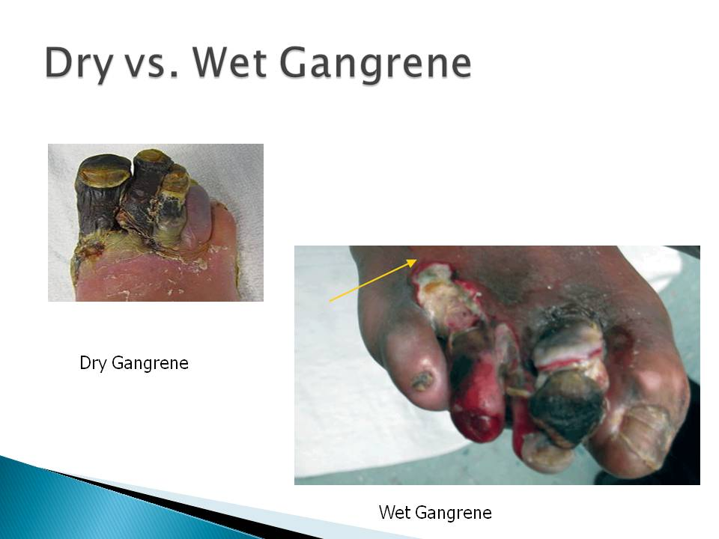

Slide 49
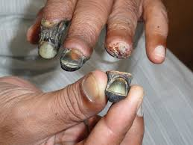

Slide 50
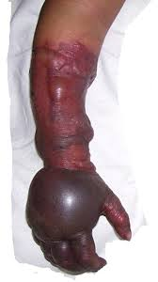

Slide 51
